Slide 1
AUTOMATIC TAGGING OF MARATHON RUNNERS BIB IDENTIFICATION AND RECOGNITION
By
Chelsea Fernandes, Sharon Mathew and Joshua Fernandes

Slide 2
Content
Abstract
Introduction
Literature Review
Problem Statement
Work Flow of the system
Dataset Description and Previous Approaches
Basic Structure
Data Preprocessing
Algorithm and Models used
GUI Design with Validation
Result Analysis
Drawbacks and Improvements
Conclusion
Reference
Notes:
what is a bib
what is our system

Slide 3
Abstract
In this project, by using deep learning and image processing we aim to create a system which will identify and recognize Bib number in natural image collections associated with each marathon runner. A bib is typically a piece of durable paper or cardboard bearing a number as well as the event/sponsor logo that is attached to the body of a marathon runner. The bib has a unique bib number, printed in big fonts, along with the runner’s name and some other text. Our system will help the marathon managing staff to upload any natural image of the marathon and get the bib no. associated with that image. Along with pictures, a video of marathon can also be uploaded to get frames of images containing bib no.s as recognised by our system and all the information about the occurrence of a bib in the video will be stored in a downloadable file using OpenCV EAST text detector and tesseract-OCR.
We aim to also display relevant information which we can gather through images and videos of the marathon in the future.
Notes:
chelsea
what is a bib
what is our system

Slide 4
Introduction
Every year, thousands of sport events take place across the globe. Most sport events, such as marathons, skiing, and cycling races hire professional photographers and provide a platform where the participants can access their photos with the help of their racing bib number (RBN) and purchase the resulting event photos.
For a long time, the bib tagging was done manually, but in recent years different techniques have emerged to perform this task automatically. These techniques stem from the vast research of text recognition in natural scene images.
Detecting text in constrained, controlled environments can typically be accomplished by using heuristic-based approaches, such as exploiting gradient information or the fact that text is typically grouped into paragraphs and characters appear on a straight line.
Notes:
sharon

Slide 5
Literature Review
Ben-Ami et al. (2012) were the first to raise the issue of automatic racing bib number recognition in academia using face recognition, torso estimation and stroke width transform.
The limitation of such method is tremendously large numbers of runners running with different speeds during running races such as marathon races and hence it is very difficult to localize and detect each runner’s face.
By using a minimum confidence and threshold and methods like non max suppression, our dedicated system overcomes these challenges.
The objective of our project is to make user friendly system for detecting bibs in the marathon pictures and videos and tagging the image with detected bib.
AUTOMATIC TAGGING OF MARATHON RUNNERS BIB IDENTIFICATION AND RECOGNITION
22/4/2020
Notes:
chelsea,
swt- cv algo
The approach of SWT is grouping pixels together in an intelligent way, instead of looking for separating features of pixels.
talking about previous implementations
Are there other implementations of your project? what are cons of thier implementations.
Now in our system we use
how is your system overcoming this?
objective?

Slide 6
Literature Review Contd.
The scope of building efficient and fast deep learning algorithm for natural scene text detection area includes using edge based, colour based methods and various image processing along with face and torso- detection steps for better results.
For our project, we used a deep learning-based algorithm (EAST) that detects text with a single neural network with the elimination of multi-stage approaches. We used tesseract-OCR for text recognition as Tesseract can work very well under controlled conditions, and the latest release of Tesseract (v4) supports deep learning-based OCR that is significantly more accurate with processing of images.
AUTOMATIC TAGGING OF MARATHON RUNNERS BIB IDENTIFICATION AND RECOGNITION
Notes:
joshua
1st two points: future scope, n other implementations that are better
last two points: tech used

Slide 7
Problem Statement
In marathons, thousands of people run together making it difficult to keep track of each and every person manually.
So a system is built using Machine learning concepts in python, which will keep a track of the competitors with the help of the Bib number , which is provided to each competitor during the race. A video stream or pictures of marathon will be provided to the system through which the Bib number will be recognized by using deep learning and image processing. The organizer can upload a csv file along with the video and check if the a Bib no. is predicted correctly.
Notes:
sharon

Slide 8
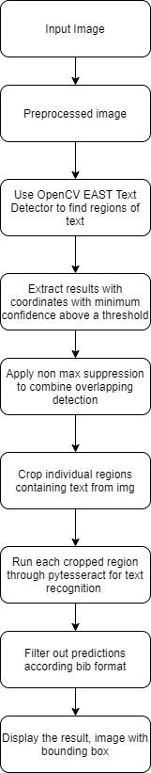
Work Flow of the system
Notes:
chelsea
breifly describes our working model
our system
resizing, normalizing of rgb

Slide 9
Dataset Description
Dataset consists of images of marathon runner throughout the world. The images are in jpg, jpeg and png formats.
The marathon runner is wearing a BIB which has a unique identification number through which the participant can be tracked.
For recognition in webcam and video files, the footage is broken down into frames and processed individually as images.
Notes:
joshua

Slide 10
Previous Approaches:
We first tried implementing text recognition directly without preprocessing the image. This gave results but not accurate enough for deployment.
The images come with alot disturbances such as other texts surrounding the BIB such us on Tshirts, sign boards, etc.
Also the BIB is usually the small part of the image, thus difficult for detection
AUTOMATIC TAGGING OF MARATHON RUNNERS BIB IDENTIFICATION AND RECOGNITION
Notes:
sharon

Slide 11
Previous Approaches:
2) We then tried preprocessing the image by converting to Grayscale to reduce features, applying, bilateral filtering and Gaussian blur for smoothening the image edges and remove noise, Canny Edge detection for prominent edge detection, thus extracting the prominent features of the image which would help text recognition.
This did improve the results considerably with 50% accuracy.
AUTOMATIC TAGGING OF MARATHON RUNNERS BIB IDENTIFICATION AND RECOGNITION
Notes:
joshua

Slide 12
Previous Approaches:
3) The method that worked best was when we used a CNN model to detect the text region and send only the particular region of image containing text cropped for text prediction .
This gave a better and a faster output.
AUTOMATIC TAGGING OF MARATHON RUNNERS BIB IDENTIFICATION AND RECOGNITION
Notes:
chelsea
Finally, after trying previous two approaches, we observed that

Slide 13
Basic Structure
Our approach is divided in primarily 4 phases:
Preprocessing
Text Area Detection using OpenCV East Detector
Text Recognition using Tesseract OCR
Prediction Filtering and Output
AUTOMATIC TAGGING OF MARATHON RUNNERS BIB IDENTIFICATION AND RECOGNITION
Notes:
chelsea

Slide 14
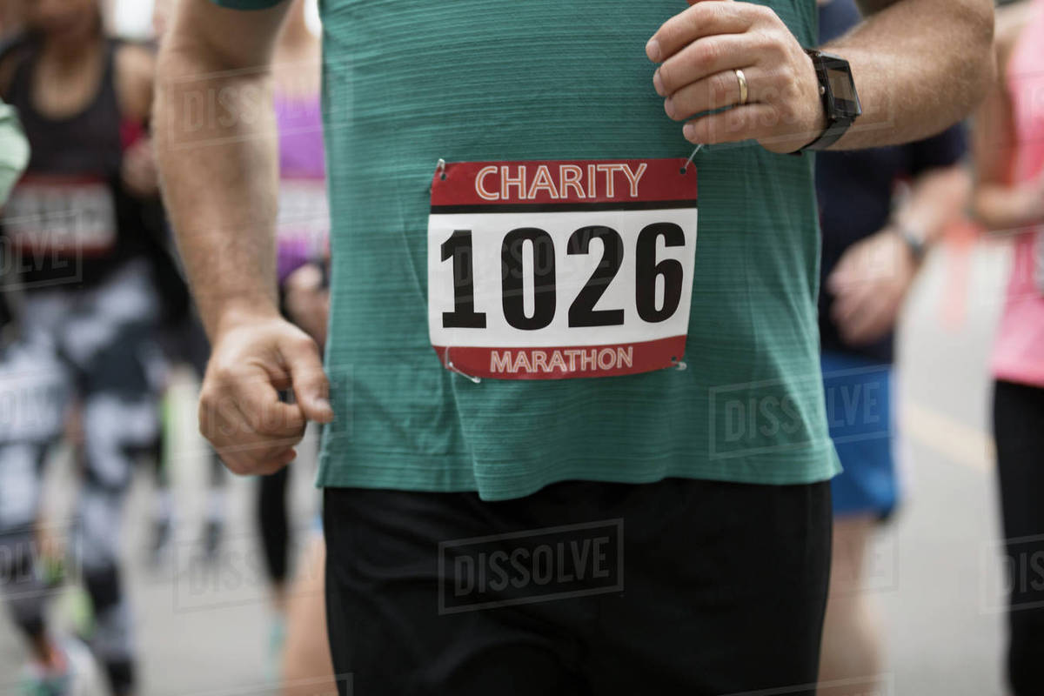
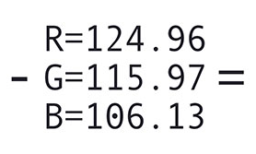
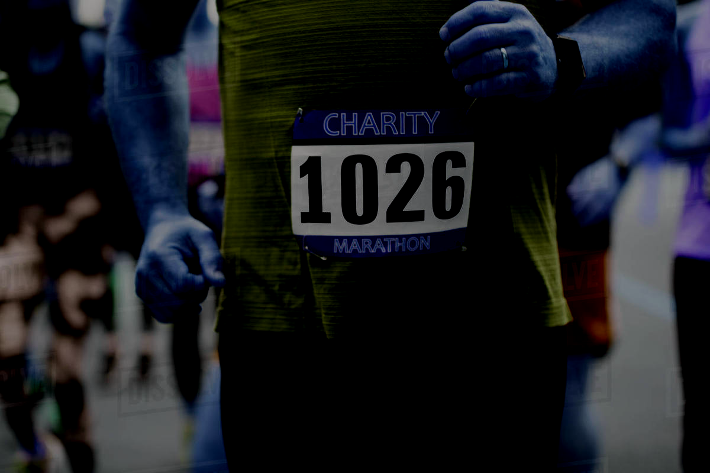
Data Preprocessing
East Detector which is used for text detection requires image size to be in multiples of 32. thus we resize the image to (320,320).
Mean subtraction is used to help combat illumination changes in the input images in our dataset.
AUTOMATIC TAGGING OF MARATHON RUNNERS BIB IDENTIFICATION AND RECOGNITION
22/4/2020
Notes:
sharon

Slide 15
Algorithms and Models used
Notes:
chelsea

Slide 16
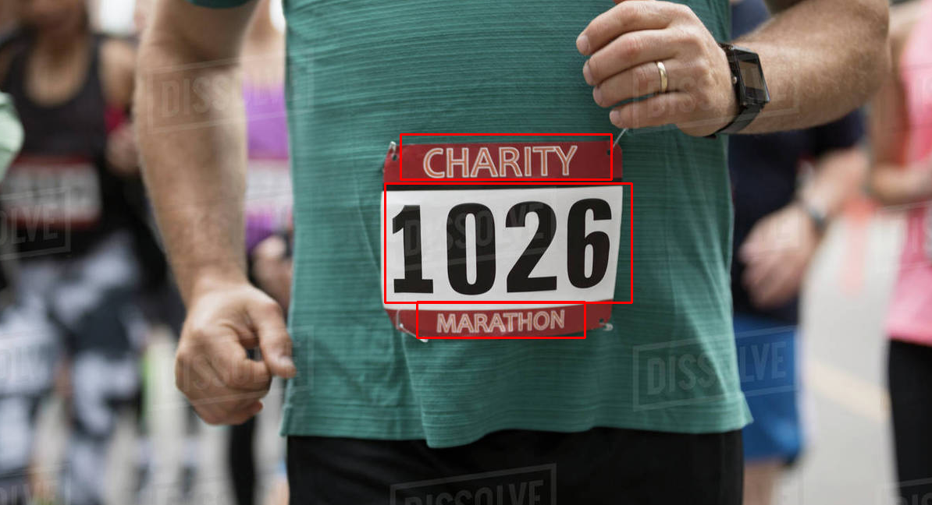
OpenCV EAST Detector
All text regions detected
Notes:
chelsea
east gives boxes where text is present

Slide 17
Feature Extraction
In OpenCV EAST Detector, the first step is feature extraction which uses the VGG16 model which is a Convolutional Neural Network which extracts the various features present hidden in images.
The model is trained on extracting TEXT data present in images of various sizes.
AUTOMATIC TAGGING OF MARATHON RUNNERS BIB IDENTIFICATION AND RECOGNITION
22/4/2020
Notes:
chelsea
in east, 1st step is feature extraction
So in feature extraction we figure out what parts of an image are distinctive , like lines, corners, special patches that can uniquely describe the image. In pattern recognition and in image processing, feature extraction is a special form of dimensionality reduction.
VGG16 has achieved an accuracy of 92.7% top-5 test accuracy in ImageNet, which is a dataset of over 14 million images belonging to 1000 classes.

Slide 18
OpenCV EAST Detector
Through OpenCV, we use a deep learning-based text detector called EAST, which is based on Zhou et al.’s 2017 paper, EAST: An Efficient and Accurate Scene Text Detector.
1. Feature Extractor Stem
This branch of the network is used to extract features from different layers of the pretrained network VGG16. it takes the output from the VGG16 model after pool2, pool3, pool4, and pool5 layers.
2. Feature Merging Branch
In this branch of the EAST network, it merges the feature outputs from a different layer of the VGG16 network. EAST uses a U-net architecture to merge feature maps gradually. Out[uts are concatenated to produce the final feature map layer before the output layer.
Notes:
joshua

Slide 19
OpenCV EAST Detector
3. Output Layer
The output layer consists of a score map and a geometry map. The score map tells us the probability of text in that region while the geometry map defines the boundary of the text box.
The model outputs scores and geometry of text regions detected in the image. Following this images are filtered according to a min-confidences threshold and finally Non-Max supression is applied.
Notes:
joshua

Slide 20
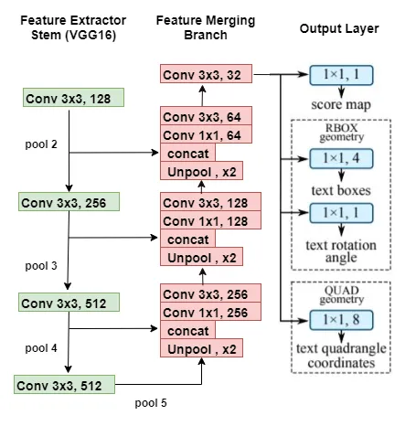
Notes:
joshua

Slide 21
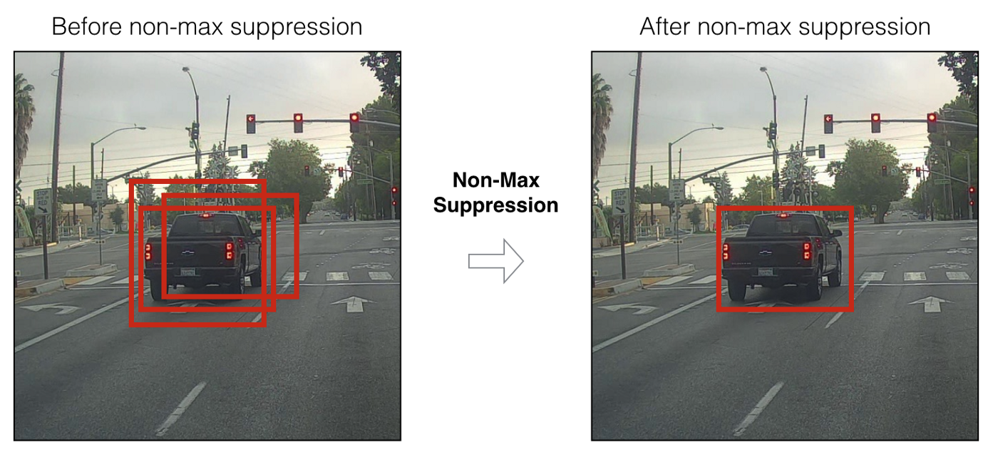
Non Max Suppression
Notes:
sharon
non-max supression removes overlapping of bounding box

Slide 22
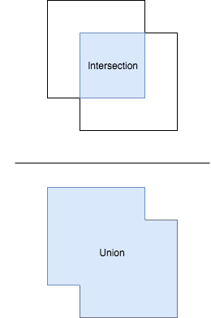
NMS is used to make sure that in object detection, a particular object is identified only once. We apply non-maximum suppression to ignore bounding boxes that significantly overlap each other.
→ It first discards all those cells where probability of object being present (calculated in final softmax layer) is <= Threshold
→ Then it takes the cell with largest probability among candidates for object as a prediction
→ Finally we discard any remaining cell with Intersection over union value >= 0.5 with the prediction cell.
Notes:
sharon

Slide 23
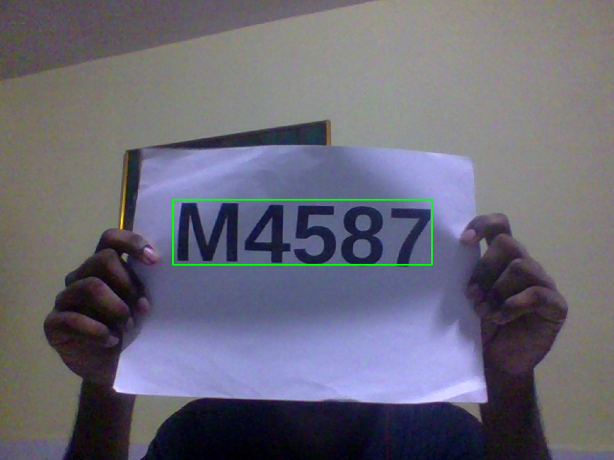
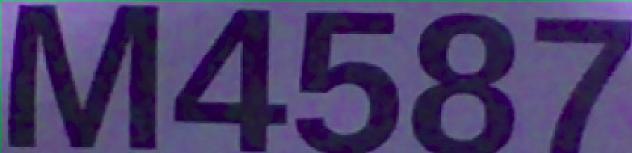
By doing text detection using OpenCV EAST detector, we get the coordinates of areas of image potentially containing text. We crop the image to those coordinates for better prediction.
AUTOMATIC TAGGING OF MARATHON RUNNERS BIB IDENTIFICATION AND RECOGNITION
22/4/2020
Notes:
chelsea
take coordinates n crop
sent this part for further

Slide 24
Tesseract OCR using pytesseract
OCR = Optical Character Recognition. In other words, OCR systems transform a two-dimensional image of text, that could contain machine printed or handwritten text from its image representation into machine-readable text.We use Py-Tesseract library to implement Tesseract.
Tesseract has unicode (UTF-8) support, and can recognize more than 100 languages. Legacy Tesseract 3.x was dependant on the multi-stage process where we can differentiate steps:
Word finding
Line finding
Character classification
Modernization of the Tesseract tool was an effort on code cleaning and adding a new LSTM model. The input image is processed in boxes (rectangle) line by line feeding into the LSTM model and giving output.
AUTOMATIC TAGGING OF MARATHON RUNNERS BIB IDENTIFICATION AND RECOGNITION
Notes:
chelsea-
It is a widespread technology to recognise text inside images, such as scanned documents and photos. OCR technology is used to convert virtually any kind of images containing written text (typed, handwritten or printed) into machine-readable text data.
Tesseract is open source ocr engine
- concept of ocr, uses of ocr, appli of ocr are very widespread - google translate,in self driving cars- traffic sign recognition, number plate recog, passport, chequebook scanning, very upcoming technque
joshau- lstm used to detect para

Slide 25
Tesseract OCR using pytesseract
M4587
AUTOMATIC TAGGING OF MARATHON RUNNERS BIB IDENTIFICATION AND RECOGNITION
Notes:
joshua

Slide 26
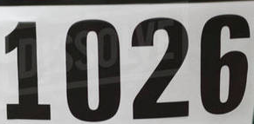

Prediction Filtering
1026 - (ACCEPT)
CHARITY - (REJECT)
All the texts will be predicted in the images. Thus to be specific one can define a regular expression specific to the BIB numbers to filter out the other texts.
AUTOMATIC TAGGING OF MARATHON RUNNERS BIB IDENTIFICATION AND RECOGNITION
Notes:
sharon
specific to particular marathon

Slide 27
INPUT
Notes:
sharon

Slide 28
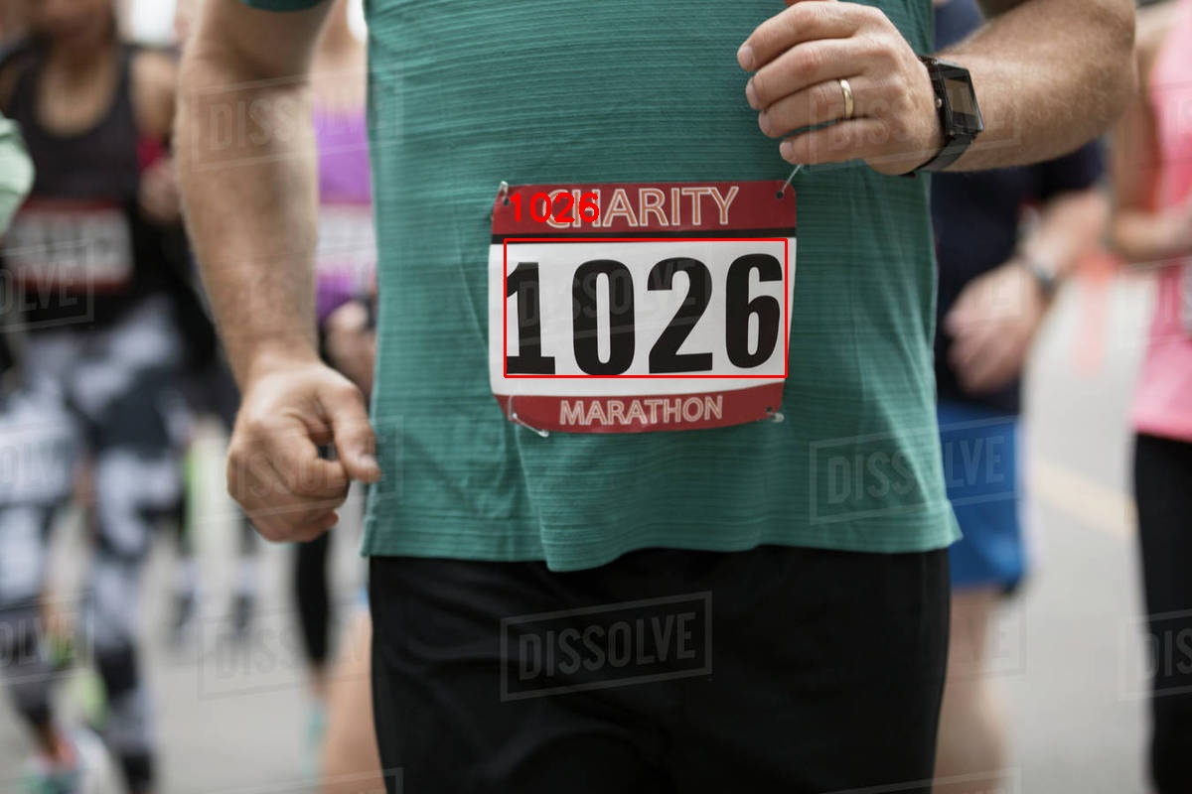
OUTPUT
Notes:
sharon

Slide 29
Working demo along with validation

Slide 30
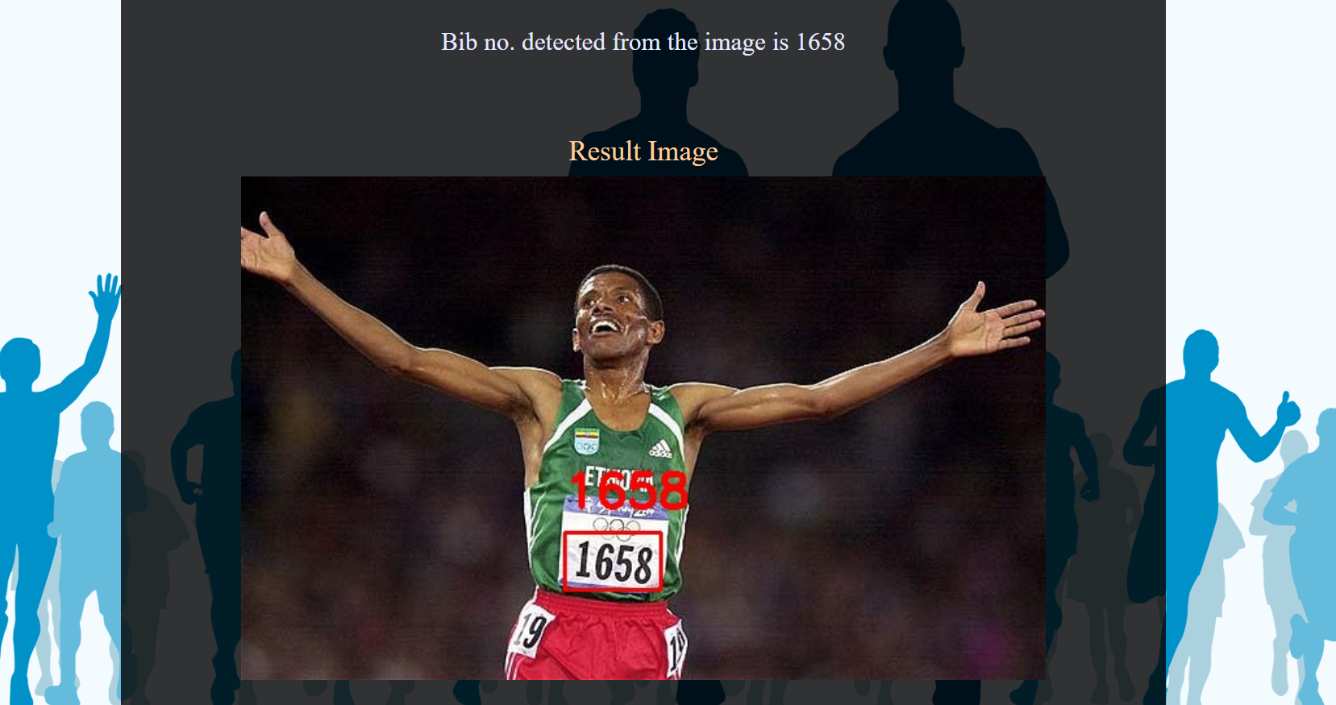
Result of Image Upload

Slide 31
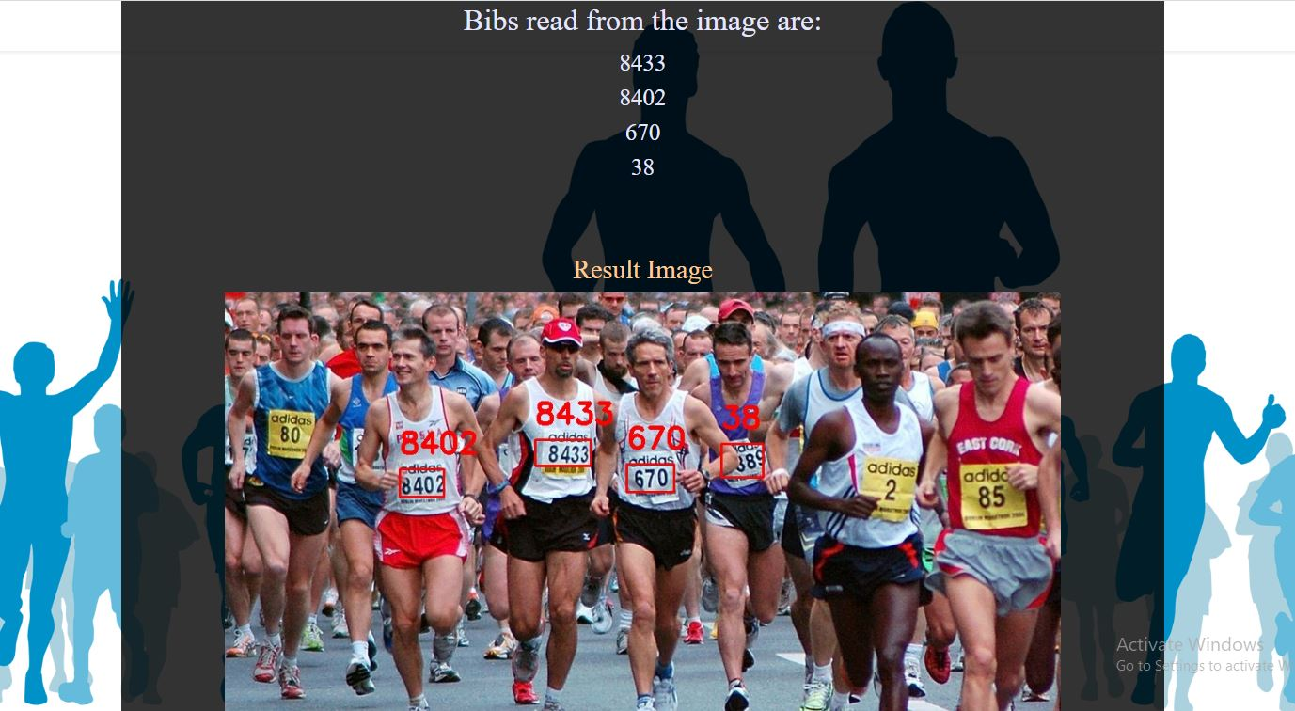
Result of Image Upload
Notes:
For demonstrating this example, we had not set any filtering ...

Slide 32
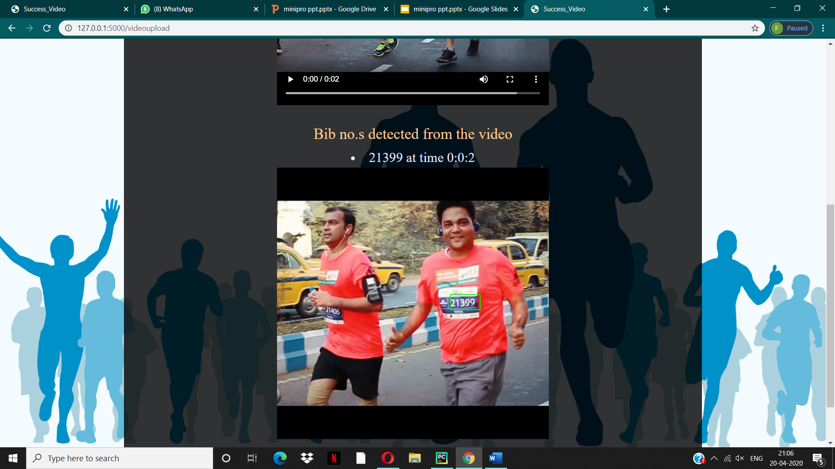
Result of a video uploaded

Slide 33
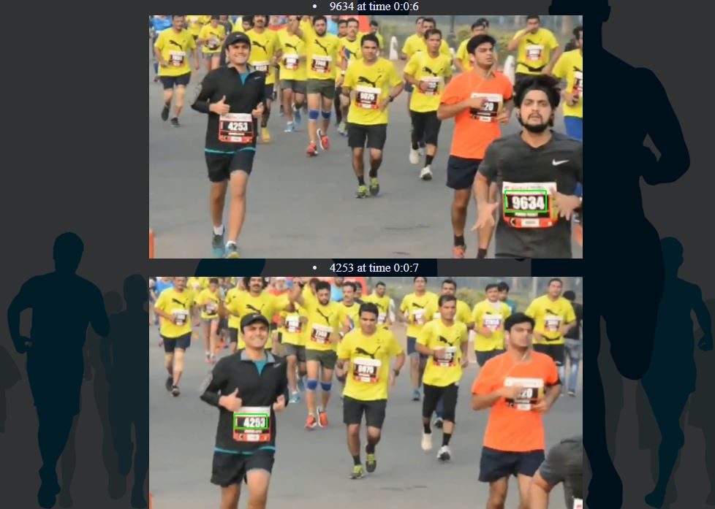
Result of a video uploaded

Slide 34
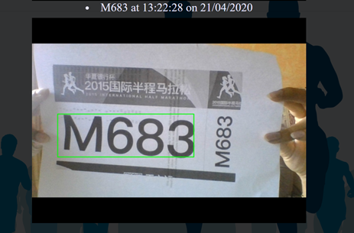
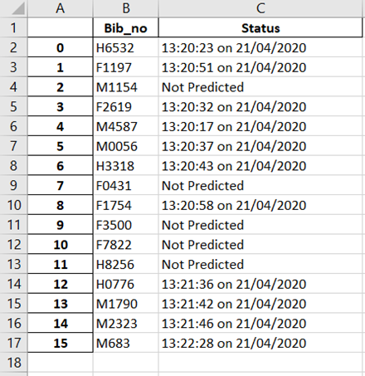
Result from webcam
Output Excel file

Slide 35
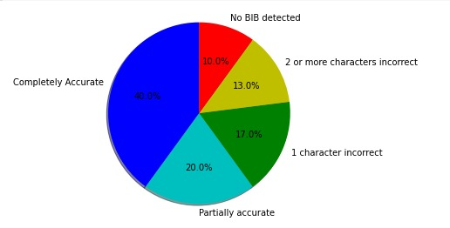
Analysis
The model proved to have an accuracy of 60% using the method we have implemented.
Notes:
joshua

Slide 36
Drawbacks:
Text oriented at an angle have issues in proper detection of BIB.
EAST detector is not specific to BIB detection thus will may not be very accurate to BIBs.
Sometimes even after proper processing, obstruction in view of BIB can hamper automated identification process.
Deployment of 2 NN makes the product complexity high and increases time taken to process an image.
AUTOMATIC TAGGING OF MARATHON RUNNERS BIB IDENTIFICATION AND RECOGNITION
Notes:
chelsea

Slide 37
Improvements:
With a proper big database of images, a neural net specific to BIB detection can be designed which will be more specific.
For better accuracy in footage detection, cameras can be placed at 2 different angles and at the particular instant the predictions from two angles can analyzed, giving better results
AUTOMATIC TAGGING OF MARATHON RUNNERS BIB IDENTIFICATION AND RECOGNITION
Notes:
joshua

Slide 38
Improvements:
3) Text detection can be coupled with Face recognition and Bibs Numbers can be linked with the person. Thus when BIB is not in view due to some obstruction, facial recognition can identify the participant.
4) Developers can work with marathon organizers and design BIBs which work best with the model.
AUTOMATIC TAGGING OF MARATHON RUNNERS BIB IDENTIFICATION AND RECOGNITION
Notes:
joshua

Slide 39
Conclusion
The system was able to recognize and locate the text/bib no. position in the images and videos. With the help of this system manually noting of the bib number from videos is reduced. The algorithm was also tested for a no. of images and videos and the performance was satisfactory. The system does not give completely accurate results if the image is blur or if there are many texts and text-like-shape that will lead to false predictions but also delivered promising results for most of the images.
Future work is to find out new methods or techniques to filter out these unwanted texts as much as possible. Face detection method can also be purposed to the system to improve the accuracy and performance of the system.
Notes:
sharon

Slide 40
References
EAST: An Efficient and Accurate Scene Text Detector :
https://arxiv.org/abs/1704.03155
2) TextBlob :
https://www.pyimagesearch.com/2017/11/06/deep-learning-opencvs-blobfromimage-works/
3) Research Paper on Racing Bib number recognition:
https://www.researchgate.net/publication/264853913_Racing_Bib_Number_Recognition
4) Blog on Marathon Bib Identification and Recognition:
https://towardsdatascience.com/marathon-bib-identification-and-recognition-25ee7e08d118
5) Natural Scene Text Understanding by Celine Mancas-Thillou and Bernard
Gosselin in their 2017 paper:
https://www.tcts.fpms.ac.be/publications/regpapers/2007/VS_cmtbg2007.pdf

Slide 41
THANK YOU

